Slide 1

SCOPE
The agents scale.
The operator does not.
Abundant AI gives every person a swarm of agents, so the work stops being the bottleneck and the human directing it becomes the bottleneck. Scope makes that human AI-native: it holds the operator's attention at the pace their agents run, restores it the moment it drifts, and proves the restoration worked with a control arm inside the device.
THE ARGUMENT
THE CLAIMS
“The Oldest Problem That Was Never Solved”
Causally Validated Wearable System for Uncertainty-Aware Cognitive-State Detection and Bounded Sensory Intervention
nirajgohil.com, June 2026
USPTO provisional, 21 July 2026. 27 claims, 18 figures.

Slide 2

01
THE PROBLEM
You can spin up infinite agents. You cannot spin up more of yourself.
The operator directing a fleet of agents is the one part of the system that does not scale. Add compute and the agents multiply. The human has the same four-item working memory and the same attention that leaves the task for half of every working hour, and nothing they own records when it happened or what it cost.
It is invisible
It is unmeasured
It is unproven
You cannot see a lapse from the inside. By the time you catch yourself, the twenty minute recovery has already been spent.
Nothing records the moment attention left the task you chose to direct. Wrist wearables track sleep and steps. None of them track the operator at work.
Every product sold against it, apps and supplements and headbands alike, asserts an effect that has never been demonstrated for you, in your context, against doing nothing.
You cannot manage what was never measured, or trust a fix that was never controlled. Scope instruments the operator: the measurement and the control in one device.
The agents are already almost superhuman. The operator is the bottleneck, and the operator has never been instrumented.
SCOPE 02

Slide 3

02
THE CONSTRAINT MOVED
When an input becomes abundant, the constraint does not disappear.
Any complex system's output is set by its binding constraint, not by its abundant input. In 2026 abundant intelligence does not mean smarter models, it means every operator runs a swarm of agents. The work is no longer scarce. What is scarce is the operator's own command: choosing what the agents work on and holding attention at the pace they run. That capacity is the oldest problem humans have written about, and no answer has ever worked instantly, the way coffee or music can bring a mind back.
BEFORE
The binding constraint is command: the ability to choose what your mind works on, and to carry that choice through to something finished.
Intelligence
(scarce)
CONSTRAINT
Output
NOW
AI provides everything else. It cannot provide either of those, and the evidence is already in that it is corroding the second one.
Intelligence
(abundant)
COMMAND
Output
CHOOSE · FINISH
Diagram reproduced from “The Oldest Problem That Was Never Solved,” nirajgohil.com, June 2026.
SCOPE 03

Slide 4
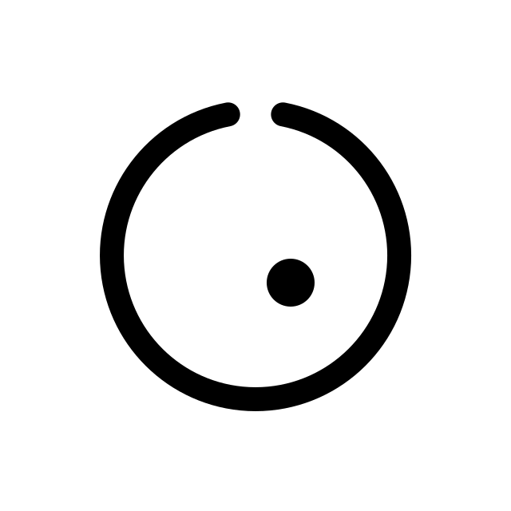
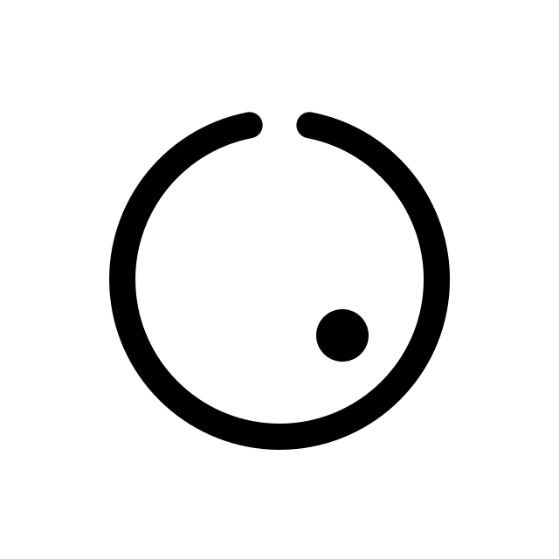


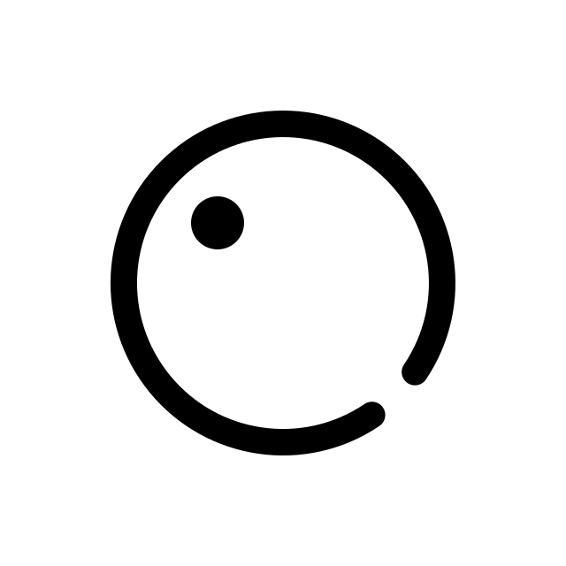

03
THE MARK
Our logo is the product spec.
Three elements, and each one is a component of the system. The dot is your attention: left alone it drifts, because that is what attention does. The ring is the work you chose, a field with a restoring pull toward its centre. The gap is us, the aperture through which that pull is applied. The dot glides back to where you decided it should be. It is never snapped back, and you are never told it left.
centred
drifting
off task
restored
drifting
off task
restored
The dot is your attention.
The ring is the work you chose.
The gap is where the restoration enters
It wants to leave. Roughly half your waking life it does, and you almost never catch it going.
A field with a pull back toward its centre, closed everywhere except at one point.
An output held below your own notice threshold, restoring the dot without ever announcing that it moved.
Drawn as a field diagram: the ring provides the restoring pull, the dot follows it, and the aperture is where the impulse enters. The mark never shows the dot pinned, because wandering you chose is not a fault.
SCOPE 04

Slide 5
04
WHAT IT DOES
Six things, precisely.
A head-worn sensing band, a wrist node, and your laptop. Dry EEG and eye-movement contacts, wrist pulse and skin-conductance, motion, and what you are actually doing on screen.
01
02
03
Watches one attention for the enrolled task
Says “unknown” when it isn't sure
Decides whether a nudge is worth it
You choose the work and the state: drifting at a task, spinning on a worry, overloaded, or wide awake at bedtime. It watches nothing else.
If the signal is unfamiliar or noisy it refuses to guess and does nothing. Most detectors are forced to answer. Ours is allowed to abstain.
Not just “is the state present” but “is acting expected to help more than it costs.” If no action clears that bar, the only option left is silence.
04
05
06
Restores you without telling you
Randomly does nothing instead
Proves the restoration worked
A sensory output held under your personal perception limit. Not an alert, not a buzz, nothing that announces that you drifted.
On a set fraction of eligible moments it deliberately withholds the output. That is the control group, and it runs forever.
It measures what was physically delivered, waits until the signal is clean again, then compares the outcome against the do-nothing moments, for you specifically.
Everything time-critical runs on the band itself. No network round trip in the decision path.
SCOPE 05

Slide 6
05
WHAT IT DOES NOT DO
Nine things it will never do.
Most objections to this category are objections to a device we did not build. Stated plainly, so nobody has to guess.
No electricity into your head
No reading your thoughts
No diagnosis
No tDCS, no tACS, no current through the skull. Haptic, sound and light only.
It never infers what you are thinking about. It detects an operational state you defined during setup.
Not a medical device. It does not detect, treat or prevent ADHD, anxiety, insomnia or anything else.
No pill, ever
No suppressing mind-wandering
No firing while you drive
Nothing ingested. A pill lasts eight hours; the thing we act on lasts ninety seconds.
Wandering is where good ideas come from. Outside the task you enrolled, it is silent.
Vehicle operation, machinery and any protected context are hard-blocked before any output is even considered.
No output it cannot verify
No claim it cannot measure
No telling you that you drifted
If it cannot confirm the output physically landed, the moment is discarded rather than counted.
It reports your measured effect against your own do-nothing moments. Never a population average dressed up as your result.
No alert, no buzz, no lapse counter. If you do start noticing the output, the psychometric bound fails and the mode shuts itself off.
The narrow scope is the strategy: it is what keeps us out of device regulation and lets us ship.
SCOPE 06

Slide 7
06
THE INTERVENTION
The correction you are not supposed to feel.
A tap tells on you. You feel it, you work out why it fired, and now you know you drifted. That is a notification with better timing. The goal is the opposite: hold the output under the threshold where you would register it, so attention returns to the work without ever being told it left. The dot glides back. It is never snapped back.
PRIMARY
FALLBACK
Stabilization output
Discrete sensory event
- Maintained rather than delivered as an event. A continuous, low-level output held beneath your own perception limit while you work.
- Where no dose region satisfies both bounds for a given person, the system falls back to a single brief output, or to monitor-only operation.
- Permitted only when two bounds hold with confidence: probability you notice, below alpha (0.05 to 0.20); probability of benefit, above beta (0.55 to 0.80).
- One to five pulses, roughly 20 to 500 milliseconds each. Sub-second in total. Haptic, acoustic or optical.
- Calibrated with ascending and descending trials, staircase selection and catch trials. Monitored in use by further catch trials and perceptual checks.
- This is the validated path and the one Proto-0 demonstrates first. It is the floor, not the ambition.
- If either bound fails at any point, the mode disables itself.
- Both modes use the same eligibility, randomization, dose and safety machinery.
Stated plainly:
the patent does not assume that an imperceptible output improves cognition, and nobody has demonstrated that it does. That is exactly why both modes are claimed, why the discrete fallback exists, and why the two psychometric bounds are a hard gate rather than a setting. Claims 17 and 24.

Slide 8
07
WHY IT CAN PROVE ANYTHING
Three mechanisms. Every other device skips all three.
A closed-loop device that detects a state, fires a cue, sees improvement and concludes it was right has proven nothing. It cannot rule out that you would have recovered anyway, cannot confirm the cue was delivered, and often measures the outcome through noise the cue itself created.
PROOF 1
PROOF 2
PROOF 3
A control arm that never stops running
Proof the output physically landed
An outcome window that opens on measurement
On a fixed fraction of eligible moments the device deliberately withholds the output, and logs the odds before it decides. Competitors run one sham-controlled study, once, across a population, before shipping. We randomize per person, per moment, forever, and report your effect.
A command is not an event. Battery sag, poor contact, clipping or a safety clip can all mean less was delivered than requested. We reconstruct the real dose from driver current, back-EMF and an accelerometer in the housing. If it fell short, the moment is discarded, not counted.
The output physically disturbs the sensor reading the result. So we watch the interference decay and open the measurement window only once it has actually settled, not after a fixed guess of a delay. No clean window, no data point. Nothing is imputed.
Claims 1, 6, 15, 16
Claims 7, 26
Claim 8
SCOPE 08

Slide 9
08
COMPETITION
Everyone stimulates. Nobody measures whether it worked, for you.
The serious players are real and well funded. They are also all pointed at sleep, and they all validate the same way: one controlled study, before shipping, across a population.
Elemind
Somnee
Apollo
Muse
SCOPE
acoustic, MIT
tACS, Berkeley
vibration
EEG tracking
Senses brain state live
Adapts the output in real time
Targets daytime attention, not sleep
Control arm running continuously, per user
Verifies the dose physically landed
Measurement window gated on clean signal
Detector firewalled from treatment response
No current through the skull
Say it precisely in the room: they randomize once, in a study, before shipping. We randomize per person, per moment, forever.
SCOPE 09

Slide 10
09
MARKET
Every AI operator is a customer. We priced for the ones who feel the pain first.
The addressable population is not knowledge workers in general. It is people who direct AI to do the work of a team and are paid on their own throughput. There are roughly 28 million professional developers today, heading past 45 million by 2030, and agent orchestration is turning a growing share of them into operators whose output is capped by their own attention.
TAM · AI OPERATORS WORLDWIDE
SAM · AI-HEAVY OPERATORS, US AND EU
SOM · 3-YEAR OBTAINABLE
$45B+
$3.8B
$378M ARR
About 45M developers and AI-native operators by 2030. At a $12K blended annual contract, the global operator-productivity market clears tens of billions a year.
The ~3.1M operators in the US and EU already running agent workflows on high-value output. This is where a $999 per month tool is an obvious expense, not a splurge.
1% of that serviceable base, about 31,500 operators. Reached through the tight, vocal communities where the earliest agent-orchestrators already gather.
Bottom up:
31,500 operators at $1,999 up front plus $999 per month is about $447M of first-year contract value and $378M in steady-state ARR. Developer counts are from 2026 industry reports; the AI-native share and 1% capture are our assumptions.
We are not selling focus into a wellness market. We are selling operator throughput into the AI-productivity market.
SCOPE 10

Slide 11
10
BUSINESS MODEL
Priced like an instrument, not a gadget.
$2,199 for the device, $999 a month for the intelligence. That is priced for an operator whose output is worth far more than the tool, not for a consumer buying focus. The device gets us on the head; the compounding asset is the personal causal estimate, which only exists while the loop runs and improves with every randomized event. Cancel and you keep the band; you lose the proof.
01
Device
$1,999 one-time
Band, wrist node, on-device processing. A one-time cost an operator clears in a fraction of a day of their own output.
02
Subscription
$999 per month
The adaptive policy, the enrollment protocols, and the personal effect report. The recurring line, and the reason a proven, compounding tool retains where a gadget churns.
03
The causal log
later, and large
A longitudinal per-operator record of randomized interventions with verified doses. Licensable to enterprises deploying agent fleets, and to clinical partners. Nobody else is collecting one.
At $999 a month, one avoided hour of a high-value operator's lapse pays for the tool. BOM and hardware margin close in Proto-0.

Slide 12
11
FOUNDERS
Two founders, Three years, one problem.
We met at a Stevens startup event in 2023, both fresh graduate students research background. We have argued about attention, cognition and where the species is heading ever since. Niraj wrote the essay and filed the patent; Jishan reviewed the essay. We split cleanly along the two halves this needs.
NIRAJ GOHIL
JISHAN RAJPAL
TECHNICAL · SYSTEMS, SIGNAL, CAUSAL ARCHITECTURE
PRODUCT · GTM, TRIALS, USERS, OPERATIONS
- Systems engineer and researcher. Models complex systems to find their binding constraint.
- Product and operations. Has carried a quota and shipped with engineers.
- Two first-authored arXiv papers with Argonne National Laboratory collaborators, on hydrogen LCA and model-based systems engineering.
- Ran A/B tests, agile rollouts and retention as an e-commerce product manager; closed $56K of B2B in one month.
- Single authored system-dynamics model of the US semiconductor supply chain.
- Assistant Project Manager running live field execution on NYC public-housing restoration: scheduling, subcontractors, QA/QC, closeout.
- Wrote the essay and drafted and filed the 27-claim patent, pro se.
- Co-author, Springer LNCE 364 (ISSI 2022), a 300-run sensitivity study on building performance.
Complementary by construction: one owns whether the device works, the other owns whether anyone uses it. Still hiring analog and firmware for the build.
SCOPE 12

Slide 13
12
WHY NOW, WHY US, WHY YOU
The company follows the argument.
This did not start as a device looking for a problem. It started as two people arguing about attention for years, which produced an essay, which produced a patent, which is now ready to build.
JUNE 2026
JULY 2026
OCTOBER 2026
The essay
The patent
Y Combinator
›
›
›
Stated the problem
Designed the solution
Builds it for real
“The Oldest Problem That Was Never Solved” argues that as AI makes intelligence abundant, the binding constraint moves to command: choosing and finishing. It shows why forty-five centuries of trying to quiet the wandering mind failed, and why the real variable is whether you chose.
27 claims, 18 figures, filed pro se. Not a better classifier. An architecture that keeps state evidence, causal evidence and safety evidence separate, so that for the first time a wearable can prove that its own intervention worked.
The argument exists. The design exists. The team exists. What we need is the platform to turn a patent into a working device: the first hardware hire, the first users, and a bench result.
nirajgohil.com
USPTO provisional, 21 July 2026
The ask
Problem identified. A solution is ideated. A platform is all we need.

Slide 14
13
THE ASK
One ask: A platform to build it.
The first hardware hire
Design partners
An analog and firmware engineer who has shipped a device with a real safety chain. We own systems and product; this is the one seat left to fill for the build.
Twenty AI-native operators, people already running agent fleets on high-value output, who will wear a rough band for six weeks. YC's network reaches them in days.
Partners who have shipped hardware
The forcing function
The wellness line is a claims-language problem as much as an engineering one. I want to be pressure-tested by people who have walked it.
A public deadline for a bench result. Nothing compresses a hardware timeline the way Demo Day does.
Use of funds:
Proto-0 bench rig and instrumentation · non-provisional filing · twelve months of solo burn
SCOPE 14

Slide 15
SCOPE
Starting was never the problem.
The machines lifted the finishing off us and left us the starting. Finished work is becoming the only hard currency left, at the exact moment we are being trained to hold soft currency in unlimited amounts. Command is choosing and finishing, and nothing anyone is building measures it. We are building the instrument.
TWO THINGS YOU CAN READ TODAY
“The Oldest Problem That Was Never Solved”
“Causally Validated Wearable System for Uncertainty-Aware Cognitive-State Detection and Bounded Sensory Intervention”
The 16-minute argument the company follows from. nirajgohil.com, June 2026.
USPTO provisional filed 21 July 2026. 27 claims, 18 figures, filed pro se.
Niraj Gohil & Jishan Rajpal
nirajgohil.com
Founders, Scope · Jersey City, NJ
@niraj_1508 · Patent pending

